Slide 1

Elliptic-curve cryptography
Chitimus Mara Ioana

Slide 2
CONTENT:
What is elliptic-curve cryptography?
Why to use it?
Comparison between RSA encryption and elliptic-curve encryption
Usages
Compatibility
What is an elliptic curve?
Addition on elliptic curves
Multiplication on elliptic curves
The elliptic curve cryptosystem
Elliptic curved cryptography on the Diffie-Hellman algorithm
Bibliography

Slide 3
What is elliptic-curve cryptography?
Elliptic-curve cryptography (ECC) is an approach to public-key cryptography based on the algebraic structure of elliptic curves over finite fields.

Slide 4

Why use elliptical-curve cryptography?
Elliptic Curves provide security equivalent to classical systems (like RSA), but uses fewer bits.
Implementation of elliptic curves in cryptography requires smaller chip size, less power consumption, increase in speed, etc.

Slide 5

For a better understanding of why elliptical-curve cryptography brings a plus, let’s make a comparison between it and the classical RSA algorithm.

Slide 6
Quick walk-through of how RSA works:
The RSA algorithm is the most popular and best understood public key cryptography system. Its security relies on the fact that factoring is slow and multiplication is fast.
Step 1: compute a maximum value (max): obtained by multiplying two random prime numbers.
Step 2: choose the public and private keys: greater than zero and less than max value, (pub and priv)
Encrypt a number: multiply it by itself pub times, making sure to wrap around when max is hit
Decrypt a number: multiply it by itself priv times to get back to the original number.

Slide 7
A set of algorithms that is easy to process in one direction, but difficult to undo are known as Trapdoor Functions. In the case of RSA, the easy algorithm multiplies two prime numbers and its difficult pair algorithm is factoring the product of the multiplication into its two component primes.
Finding a good Trapdoor Function is important when making a secure public key cryptographic system.
Simplistically: the bigger the gap between the difficulty of going one direction in a Trapdoor Function and going the other, the more secure a cryptographic system based on it will be.

Slide 8
That said, factoring is not the hardest problem on a bit for bit basis. Specialized algorithms (like the Quadratic Sieve and the General Number Field Sieve) were created to tackle the problem of prime factorization and have been moderately successful.
These factoring algorithms get more efficient as the size of the numbers being factored increases. The gap between the difficulty of factoring large numbers and multiplying large numbers is shrinking as the number (i.e. the key's bit length) gets larger. This determines the size of the keys to grow even faster and this is not sustainable for mobile and low-powered devices that have limited computational power. The gap between factoring and multiplying is not sustainable in the long term.

Slide 9
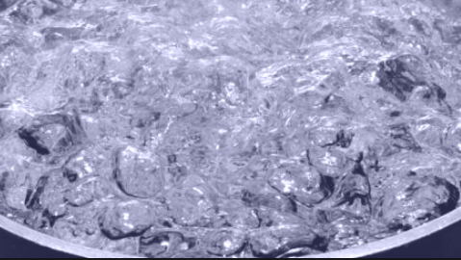
Lenstra introduced the concept of "Global Security.“ : you can compute how much energy is needed to break a cryptographic algorithm and compare that with how much water that energy could boil. This is a kind of cryptographic carbon footprint.
By this measure, breaking a 228-bit RSA key requires less energy to than it takes to boil a teaspoon of water. Comparatively, breaking a 228-bit elliptic curve key requires enough energy to boil all the water on earth. For this level of security with RSA, you'd need a 2,380-bit RSA key.

Slide 10
Conclusion: with ECC, you can use smaller keys to get the same levels of security.
Small keys are important, especially in a world where more and more cryptography is done on less powerful devices like mobile phones. While multiplying two prime numbers together is easier than factoring the product into its component parts, when the prime numbers start to get very long even just the multiplication step can take some time on a low powered device. You could continue to keep RSA secure by increasing the key length but that comes with a cost of slower cryptographic performance. ECC appears to offer a better tradeoff: high security with short, fast keys.

Slide 11
Usages:
After a slow start, elliptic curve based algorithms are gaining popularity and the pace of adoption is accelerating. Elliptic curve cryptography is now used in a wide variety of applications:
the U.S. government uses it to protect internal communications
the Tor project uses it to help assure anonymity
it is the mechanism used to prove ownership of bitcoins
it provides signatures in Apple's iMessage service
it is used to encrypt DNS information with DNSCurve
it is the preferred method for authentication for secure web browsing over SSL/TLS

Slide 12

Compatibility (Operating System):

Slide 13

Compatibility (Browser):

Slide 14
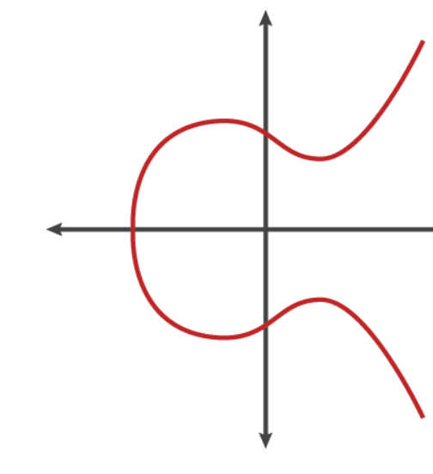
What is an elliptic curve?
An elliptic curve is the set of points that satisfy a specific mathematical equation. The equation for an elliptic curve looks like this:
y² = x³ + ax + b
That graphs to something that looks like fig 1.
fig 1

Slide 15
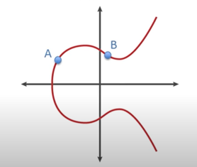
ADDITION
Adding two points:
Step 1: choose the two points A and B

Slide 16
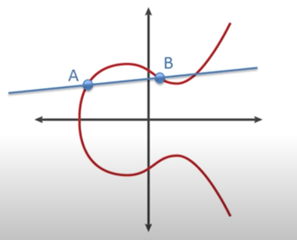
ADDITION
Adding two points:
Step 1: choose the two points A and B
Step 2: draw the line between them

Slide 17
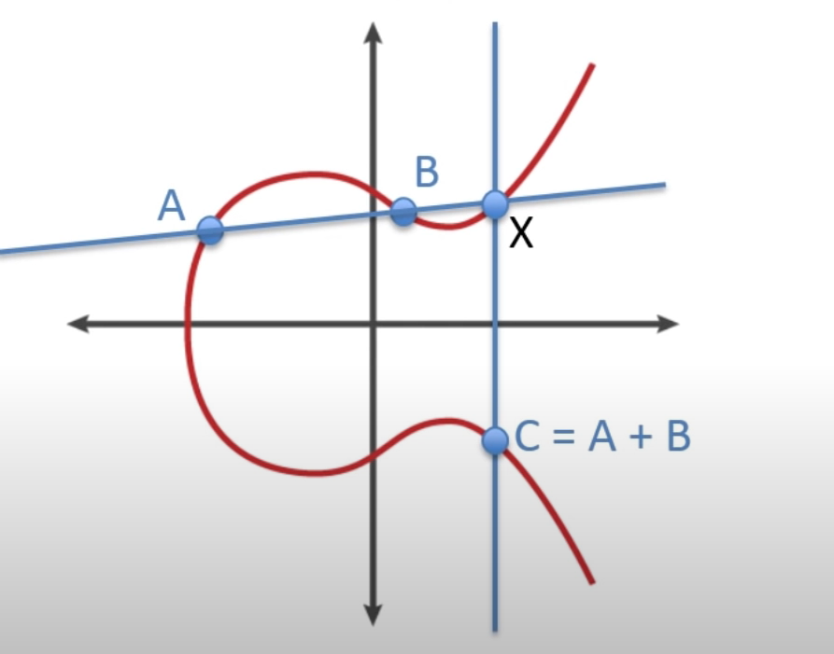
ADDITION
Adding two points:
Step 1: choose the two points A and B
Step 2: draw the line between them
Step 3: from the third intersection point of this line and the graph, draw a vertical line, across the x-axis; the intersection point (named C) will be the sum of A and B

Slide 18
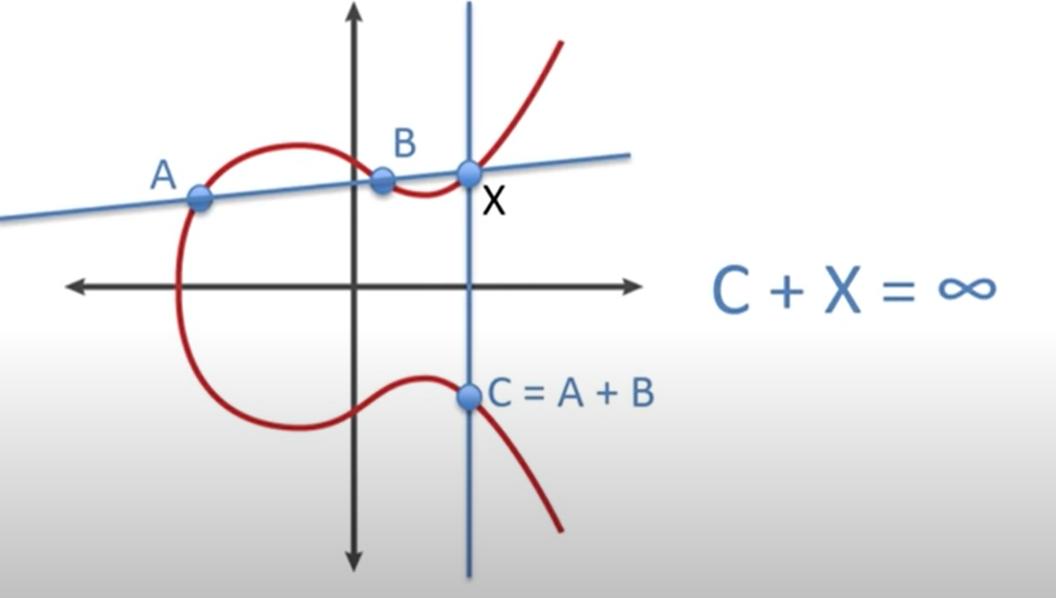
ADDITION
Adding two points:
Step 1: choose the two points A and B
Step 2: draw the line between them
Step 3: from the third intersection point of this line and the graph, draw a vertical line, across the x-axis; the intersection point (named C) will be the sum of A and B
The addition requires a third intersection point (on our graph X). Adding two vertical points results in the elliptic identity, which is infinity.

Slide 19
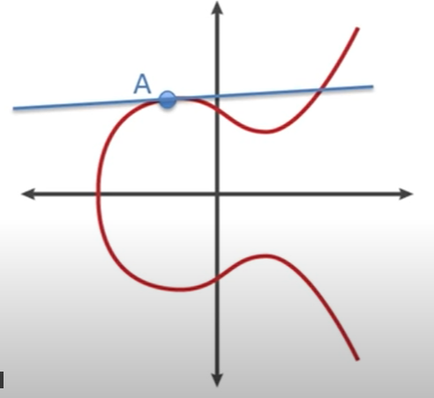
ADDITION
Adding a point to itself:
Step 1: draw the line tangent to A

Slide 20
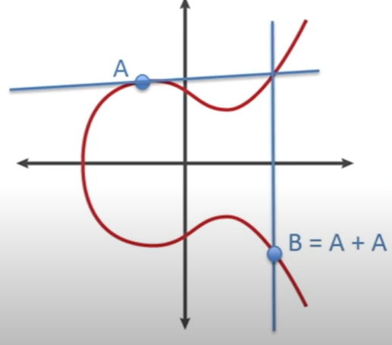
ADDITION
Adding a point to itself:
Step 1: draw the line tangent to A
Step 2: draw a vertical line from the intersecting point of the tangent and the graph, across the x-axis; the intersection point (named B) will be the sum of A and A
This is referred to as “Point Doubling”.

Slide 21
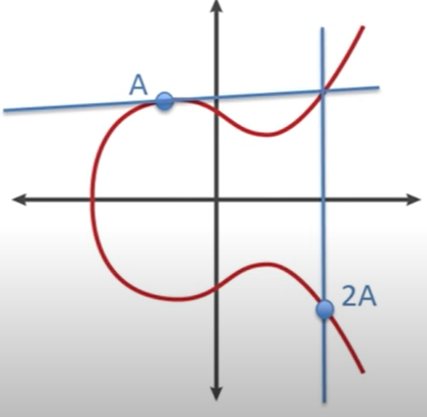
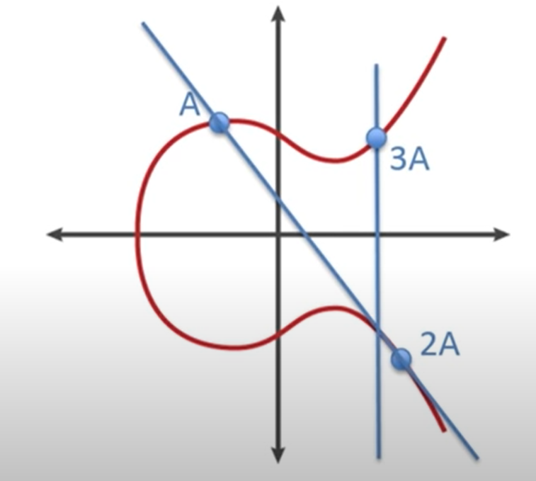
MULTIPLICATION
Multiplication occurs when you repeatedly point double one point.

Slide 22
The elliptic curve cryptosystem
An elliptic curve cryptosystem can be defined by picking a prime number as a maximum, a curve equation and a public point on the curve.
A private key is a number priv, and a public key is the public point multiplied with itself priv times.
Computing the private key from the public key in this kind of cryptosystem is called the elliptic curve discrete logarithm function. If you have two points (an initial point multiplied with itself n times and a final point), finding out n becomes infeasible. Easy to do, hard to undo: this is the basis for a very good Trapdoor Function.

Slide 23

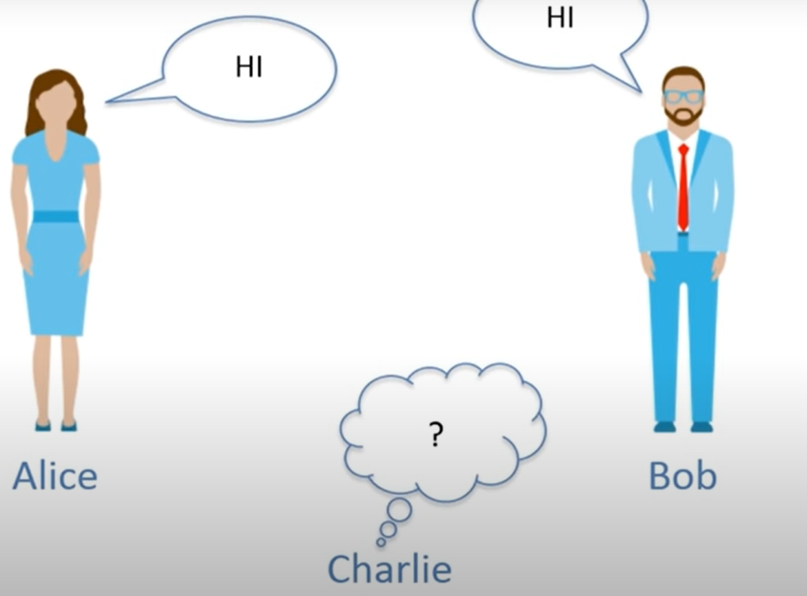
Elliptic curved cryptography on the Diffie-Hellman algorithm

Slide 24
Domain parameters:
p = the field that the curve is defined over
a, b = values that define the curve
G = generator point ( point to be multiplied)
n = prime order of G (smallest prime number such that
nG = elliptic identity(infinity)
h = cofactor (number of points over the curve, ideally 1)
For the following algorithm, public elements will be green and the private ones red.

Slide 25
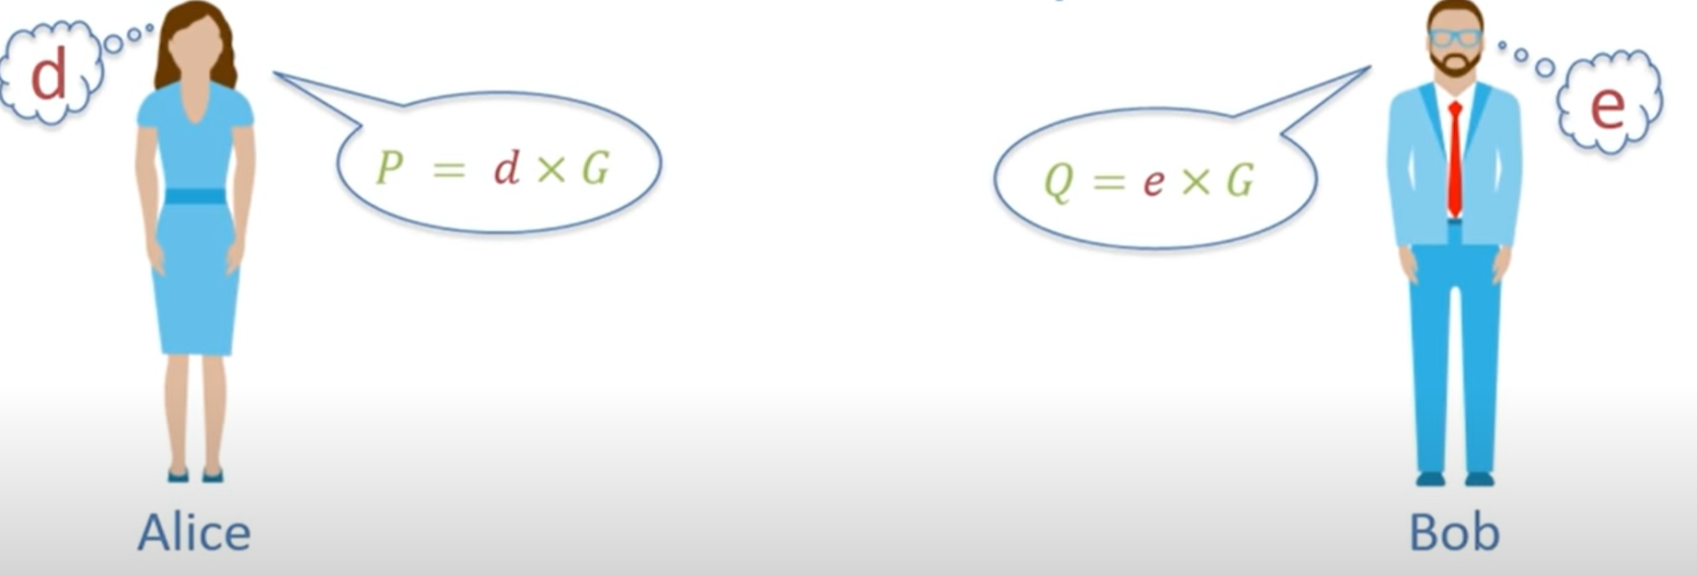

Algorithm:
Step 1: Both Alice and Bob need to choose each a private random value d (and e respectively), where 1≤ d (or e) ≤ n-1
Step 2: Each will calculate some point with the formula
d x G = ($X_{G},Y_{G})$ = P , e x G = ($X_{1G},Y_{2G})$ = Q
and share the point with the other

Slide 26
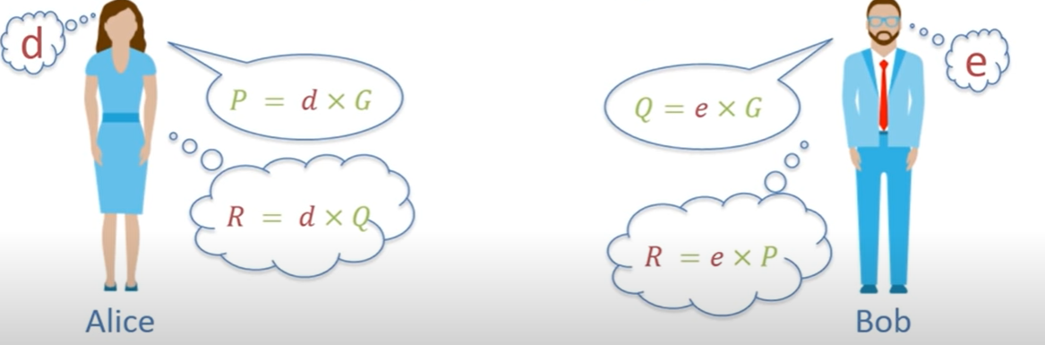


Algorithm:
Step 1: Both Alice and Bob need to choose each a private random value d (and e respectively), where 1≤ d (or e) ≤ n-1
Step 2: Each will calculate some point with the formula
d x G = ($X_{G},Y_{G})$ = P , e x G = ($X_{1G},Y_{2G})$ = Q
and share the point with the other
Step 3: Each will calculate a final point R with the formula:
d x Q= R , e x P = R
Thus: R = d x e x G = ($X_{G},Y_{G})$
Usually, the X coordinate is the hashed version of the information being transferred

Slide 27
Bibliography
https://blog.cloudflare.com/a-relatively-easy-to-understand-primer-on-elliptic-curve-cryptography/
https://www.youtube.com/watch?v=yDXiDOJgxmg
https://www.youtube.com/watch?v=NF1pwjL9-DE
https://en.wikipedia.org/wiki/Elliptic-curve_cryptography#:~:text=Elliptic%2Dcurve%20cryptography%20(ECC),fields)%20to%20provide%20equivalent%20security
http://www.umsl.edu/~siegelj/information_theory/projects/EllipticCurveEncyiption.pdf
https://cryptobook.nakov.com/asymmetric-key-ciphers/elliptic-curve-cryptography-ecc
https://www.keycdn.com/support/elliptic-curve-cryptography

